Slide 1
Campaign Planning
APM 2002
Module Leader: Denisha Seereekissoon
Client: Katrin Caine Voice Academy

Slide 2
Hello
And Welcome To Our Presentation
We are a campaign agency that makes companies memorable. We promote focused effort that guides consumers to the desired actions of our clients. We also give brands emotion, personality and identity with our marketing campaigns which is needed for striving businesses. Our job is to inform, to remind and to persuade our client. Our objectives are customer satisfaction, online responsibility and continuous improvement.
.

Slide 3
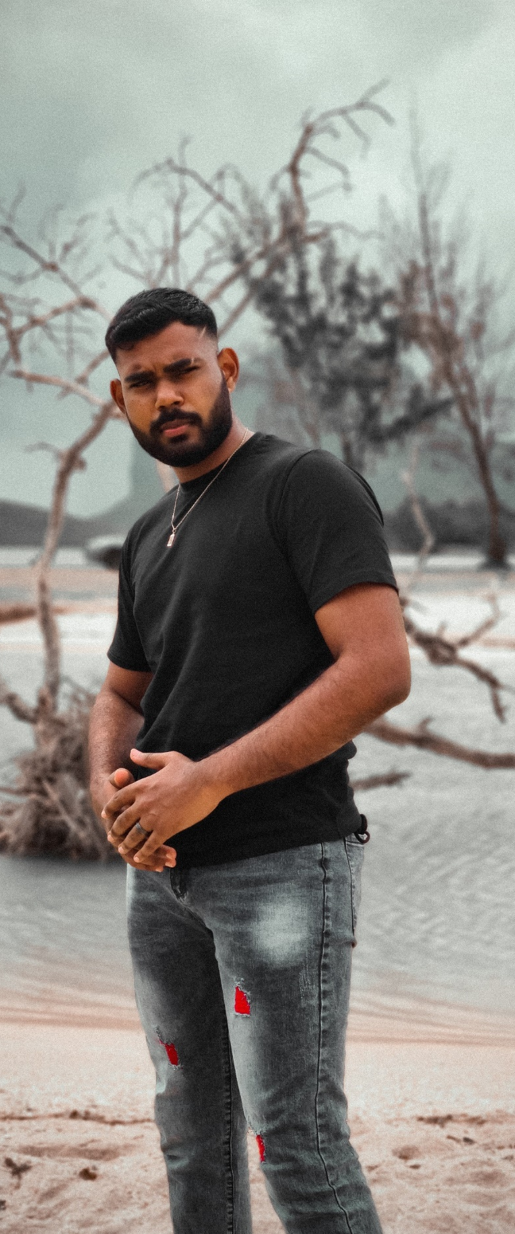
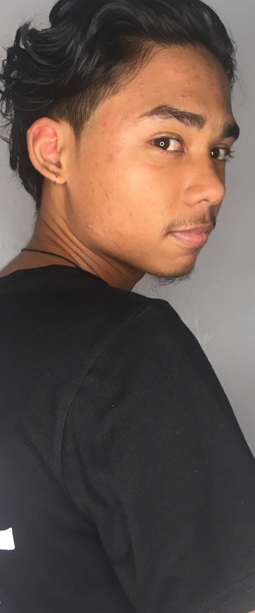
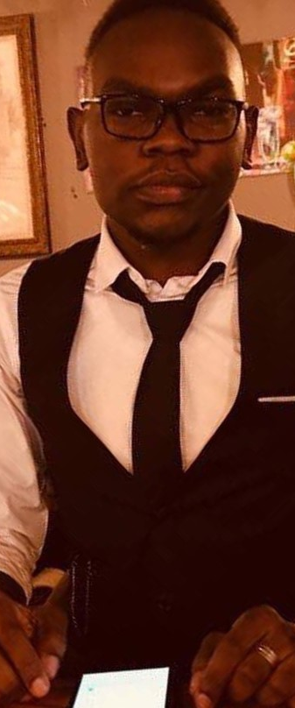
Our
Team
Rohan Choolhun
O’brien Lch
Edgar Martin
Ishika Gunesh

Slide 4
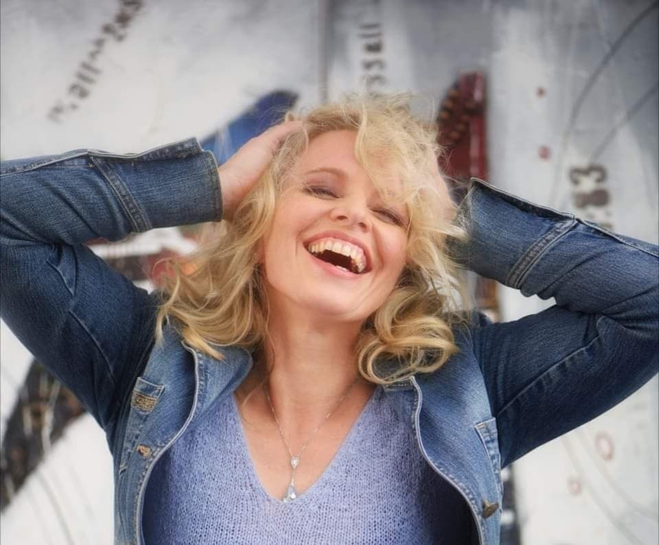
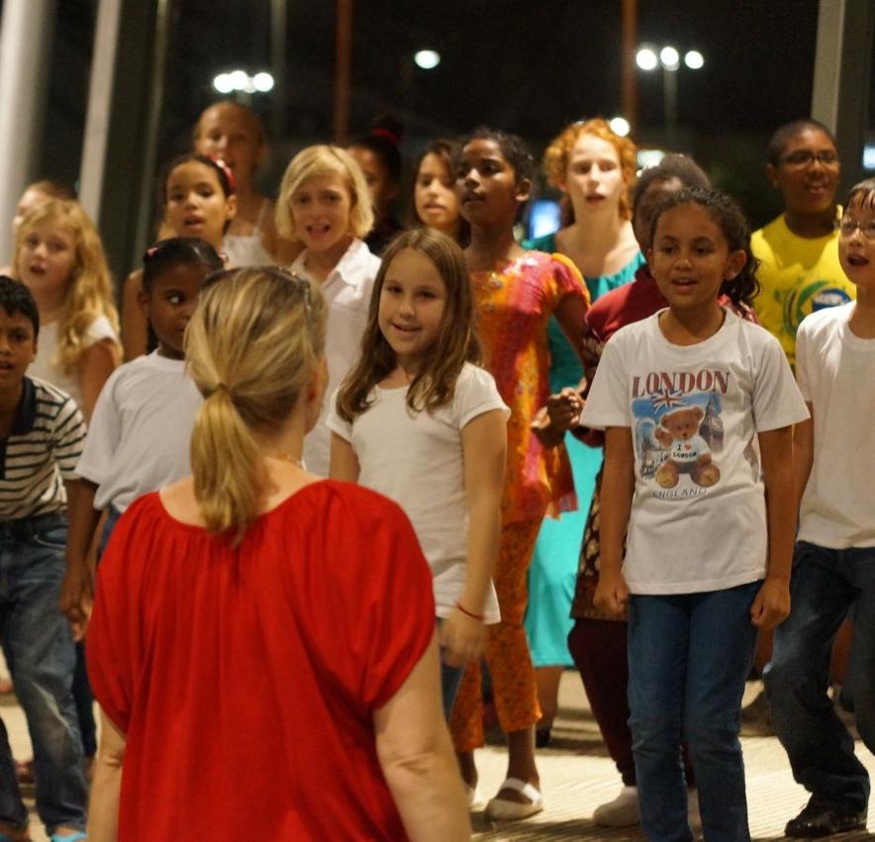
Katrin Caine & Katrin Caine Voice Academy
Katrin Caine was born in Annaberg-Buccholz and studied singing and musical education at the University of Music Augsburg-Nurnberg. Having worked for ten years as a teacher for voice coaching and choir at the music school of Grunwald in the south of Munich, it is her passion to make people discover classical music, opera and the art of singing itself.
After coming to Mauritius, Katrin Caine, together with Paul Olsen and Martin, founded Wettges Opera Mauritius, and soon after she founded the Katrin Caine Voice Academy at Petite Riviere Noire, which is governed by herself.
Katrin Caine Voice Academy offers a panoply of singing courses for each and everyone, varying from kids to adults and older adults.

Slide 5
Brief Introduction
Katrin Caine was born in Annaberg-Buchholz. She studied singing and musical education at the University of Music Augsburg-Nürnberg after moving to Mauritius She founded a singing academy and with its notable success.
She wanted to reach to a wide audience and get more students to signup for group courses and people for her services.
She was yet to decide whether she wants to promote her own name or company name.
She would like to have her website revamped.
She is looking for an agency to research and market more strategically her brand.

Slide 6
Findings and Data Collection
What we found while doing the campaign is that before presenting to our client all the work must be organized and well-presented. All members must be on the same page when it comes to the following assigned tasks, distribution of workload, flow of ideas and more.
With this campaign we found that making a website had a lot of moving parts and we had to always keep the client in the loop for feedback in order to create a new good media platform for her work as we worked on the #Get singing campaign.
We found that influencers were a great steppingstone to increase the engagement for this project although there were some issues in communication. At last, we managed to secure an influencer to promote the singing contest. Producing posters and brainstorming new ideas was much easier with the cooperation of everyone.

Slide 7
Budget
Influencer Fees = Rs 4000
Social Media Boost = Rs 2000
*Budget = Rs 6000

Slide 8
Target
Audience
Our target audience is aged 6-12, young adults and 18-30-year-old we look for those with a passion for singing.
6-12
Young Adults
18-30

Slide 9
Tone of voice
Competitive
Engaging
Fun
Enthusiastic
Passionate
Cheerful
Purpose
Engage
Educate
Entertain

Slide 10
Concept
Introduction
While thinking of ways to promote the voice academy the idea of the Get singing contest was set in motion with lots aspects to look into to pull off this project everyone’s help and cooperation was the reason for the success. What we looked into were posters designs, website and sponsors for the competition, a drop box on the website for the videos of the contestants, a voting system, finding an influencer to promote the contest while adjusting content on the website as the contest was underway, and we managed to successfully finish the project on schedule for our client.

Slide 11
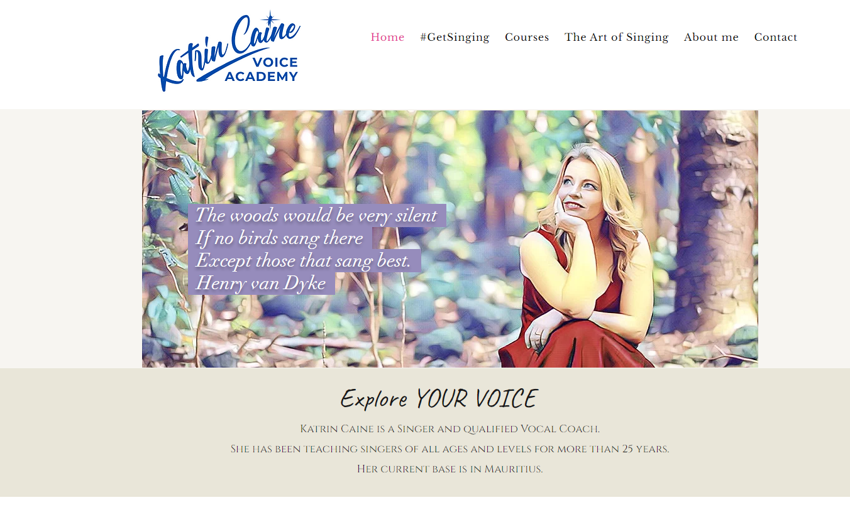
Website
Website is an essential tool for business to establish credibility and build trust with viewers.
General Informations
Events
Courses
Social Media

Slide 12
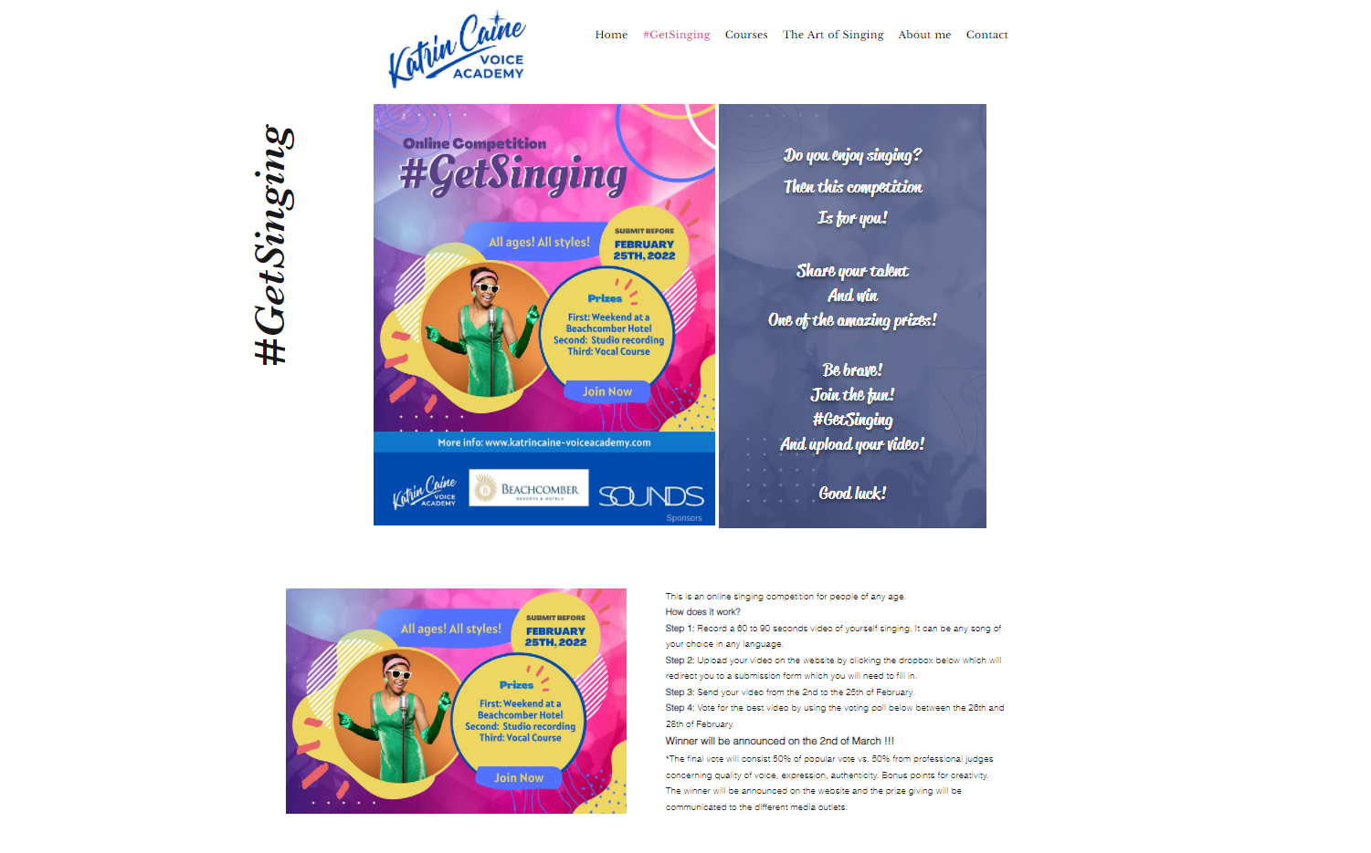
#Getsinging
Introduction of the concept.
The different categories.
Videos.
Dropbox.
Voting poll.
Sponsors.

Slide 13
Instagram
Instagram offers brand engagement that is 25% higher than all other social networks.

Slide 14
How to participate?
Submission Form
A submission form was created to collect the details of all participants to have a better record.

Slide 15
How to vote?
Voting Poll
A voting poll was created so that viewers can vote for their favourite participant for each category.

Slide 16
Excel sheet Database
The database stores information more efficiently and can handle volumes of information that would be unmanageable.

Slide 17
The # was used to get trended more easily.
Poster
Details of competition such as dates and rewards.
Poster allow you to spread your message to a wide audience far cheaper other medias in a simple, easy and affordable way.
Sponsors.

Slide 18
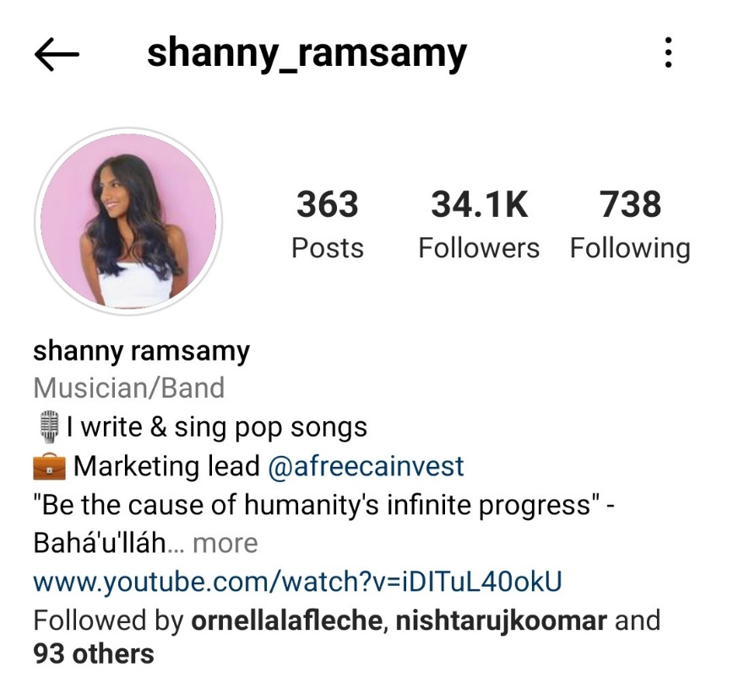
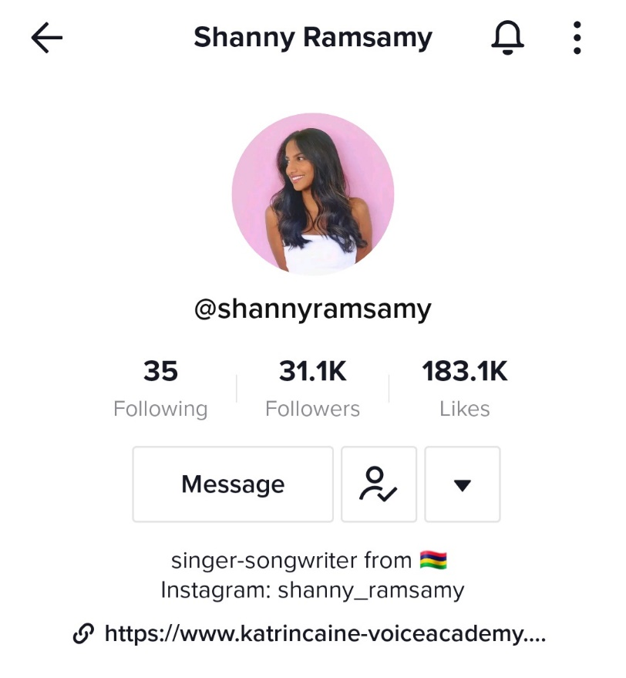
Collab
34.1k
31.1k
2 Instagram stories + 1 TikTok Post.
Followers
Followers
On Instagram.
On TikTok.
Collab Fees
Our
Goals

Slide 19
Influencer video
Engagement received after this video:
Our total number of videos went from 15 videos to 49 videos in 4 days.
Our
Goals

Slide 20
Radio Advertising
Radio One
MBC Kool Fm
4 February 2022
16 February 2022

Slide 21
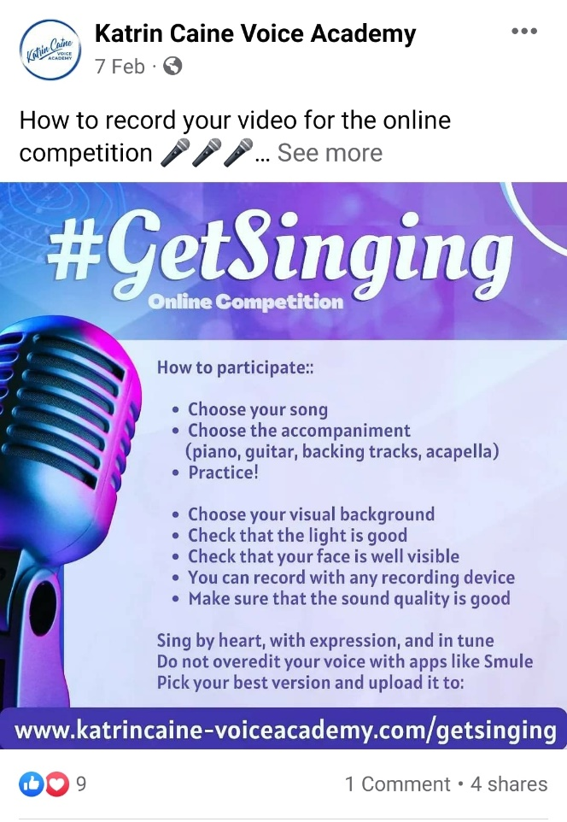
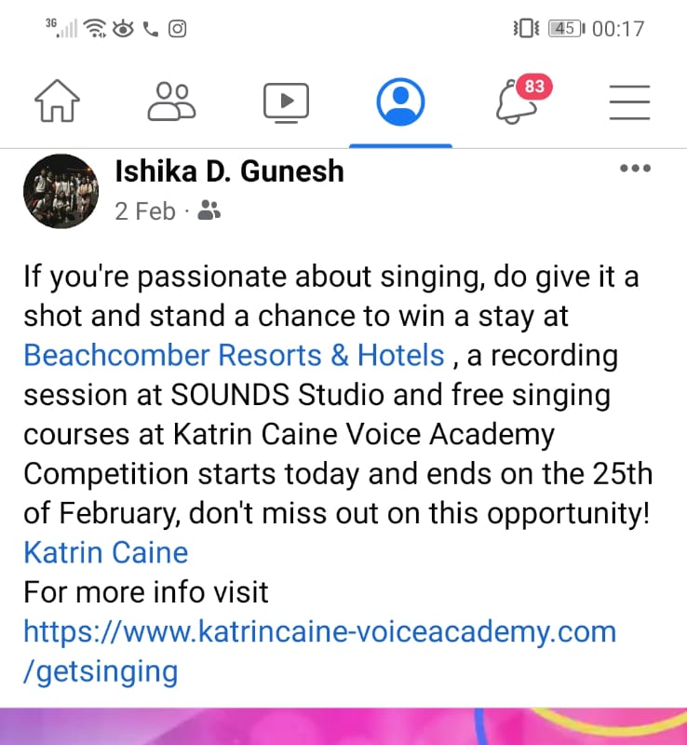
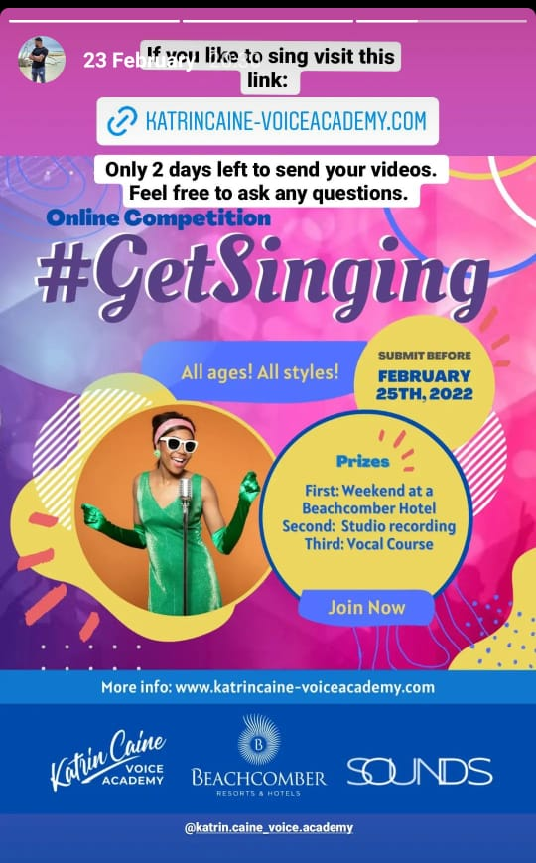
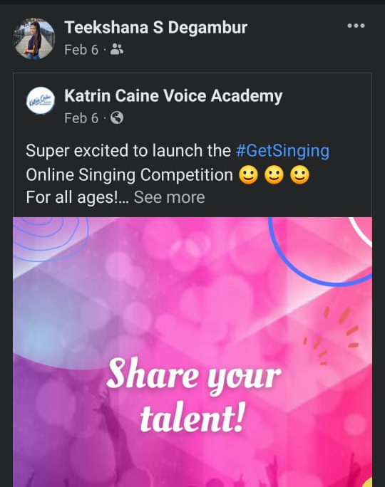
Social Media
Advertising
Our agency did everything in their power to promote the campaign on their own by posting about it on social media and encouraging friends and family to participate. The competition poster was constantly shared on social media to help get the word out to as many people as possible. Videos and posts regarding the competition were shared on Katrin Caine Voice Academy's Facebook and Instagram pages.

Slide 22
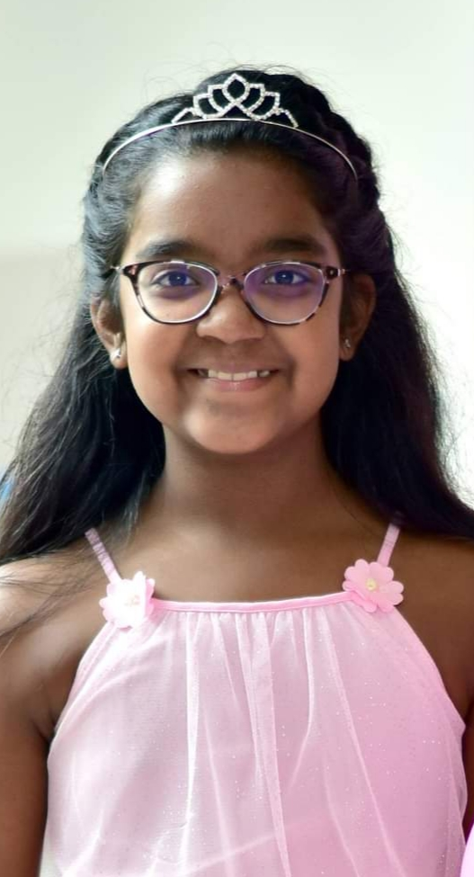
COMPETITION WINNERS
There were 4 winners in total:
Three from the adult's category and one from the children’s category.
CHILDREN’S CATEGORY
ADULTS’ CATEGORY
The prize for the kids’ category was allocated to Lisa-Maria who won a family stay at Beachcomber Resort & Spa
The first prize was allocated to Ishika Gunesh who won a stay at Beachcomber Resort & Spa
The second prize was allocated to Yenela Liyanage who won a recording session at SOUNDS Studios
The third prize was allocated to Macha Pierrus who won free singing courses at Katrin Caine Voice Academy

Slide 23
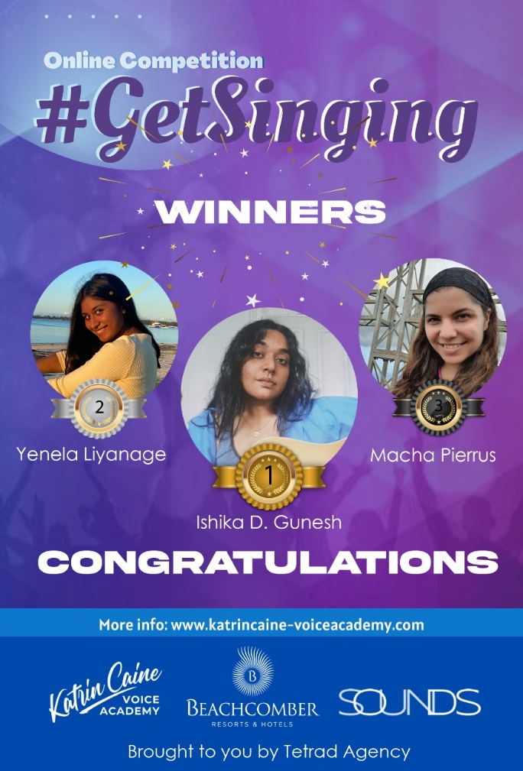
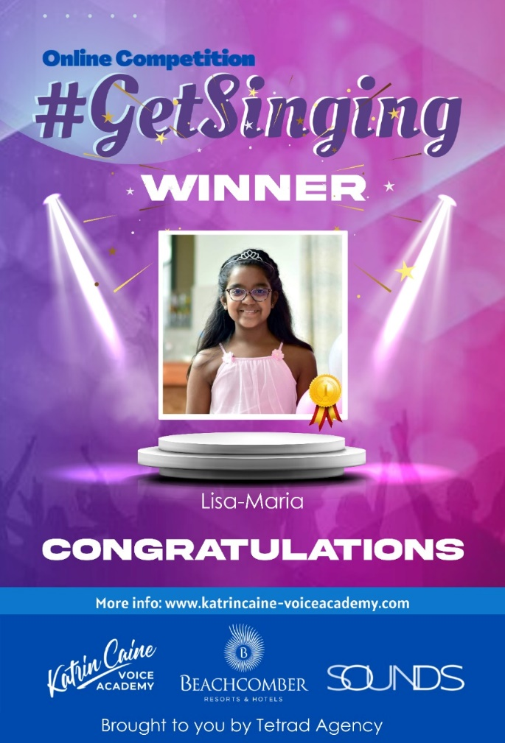
COMPETITION WINNERS
Social Media Posts
Adult’s Category
Children’s Category

Slide 24
CAMPAIGN OUTCOME: SUCCESS
TARGET
TARGET
VOTES
OUTCOME
Get more people to interact with Katrin Caine Voice Academy
More than 2000 people interacted with the Katrin Caine Voice Academy website
Initial Target : 20 videos
Outcome: 49 videos
Total number of votes: 2922
Children category: 878
Adult Category: 2044

Slide 25
Thank you for your attention.
Any Questions?

